Slide 1
MYTHILI D
211521104093
3 YR B.E CSE

Slide 2
CHURN PREDICTION FOR BANK CUSTOMER
LET’S INDULGE THROUGH AI

Slide 3
AGENDA
The agenda for our presentation on churn prediction for bank customers using artificial neural networks (ANNs) is structured to provide a comprehensive understanding of the topic. We'll begin by introducing the concept of churn prediction and its significance for banks, followed by an overview of artificial neural networks (ANNs) and their advantages for predictive modeling. Next, we'll delve into the crucial aspects of data preparation and feature engineering, highlighting the techniques necessary for effective analysis. Then, we'll explore the construction of an artificial neural network model for churn prediction, covering its architecture, training process, and evaluation metrics. A detailed case study will showcase the practical application of ANNs in predicting customer churn within the banking sector, along with insights and recommendations derived from the analysis. We'll also discuss the challenges inherent in churn prediction and potential avenues for future research. Finally, we'll conclude with a summary of key points, emphasizing the importance of churn prediction for banks, and open the floor for a Q&A session to facilitate further discussion and exploration.

Slide 4

PROBLEM STATEMENT
The problem statement for churn prediction for bank customers using artificial neural networks (ANNs) revolves around the need for banks to anticipate and prevent customer attrition. In the highly competitive banking industry, retaining customers is crucial for maintaining profitability and sustaining growth. However, identifying customers at risk of churning is challenging due to various factors such as changing preferences, competitor offerings, and economic fluctuations. Traditional methods of churn prediction often lack accuracy and fail to capture complex patterns in customer behavior.

Slide 5
PROJECT OVERVIEW
The topic of churn prediction for bank customers using artificial neural networks (ANNs) encompasses the application of advanced predictive analytics techniques to address a critical challenge faced by banks: customer attrition. In this overview, we'll explore the significance of churn prediction in the banking industry, the role of artificial neural networks in predictive modeling, and the key components involved in implementing a successful churn prediction system.
Churn prediction refers to the process of identifying customers who are at risk of leaving a business, in this case, banks. Customer churn can have significant financial implications for banks, including loss of revenue, reduced market share, and diminished customer loyalty. By accurately predicting churn, banks can implement targeted retention strategies to mitigate attrition and foster long-term customer relationships.

Slide 6
Artificial neural networks (ANNs) are computational models inspired by the structure and function of the human brain. ANNs excel at capturing complex patterns and relationships in data, making them well-suited for predictive modeling tasks like churn prediction. By leveraging ANNs, banks can analyze vast amounts of customer data, including demographic information, transaction history, and customer interactions, to identify behavioral indicators of churn.
The implementation of a churn prediction system using ANNs involves several key components, including data preparation and feature engineering, model building and training, and evaluation and interpretation of results. Data preparation involves cleaning and preprocessing the data to ensure its quality and relevance for analysis. Feature engineering involves selecting and transforming relevant features from the data to feed into the ANN model.
The ANN model is then constructed and trained using historical customer data, with the goal of learning patterns and relationships that can accurately predict future churn. Model evaluation involves assessing the performance of the ANN model using various metrics, such as accuracy, precision, recall, and F1-score, to determine its effectiveness in predicting churn.

Slide 7
END USERS

Slide 8
1.Bank Executives and Managers:
Bank executives and managers are primarily concerned with the overall performance and profitability of the bank. They rely on churn prediction models to understand customer behavior, identify trends, and make strategic decisions to retain valuable customers and optimize business operations.
2.Customer Relationship Managers:
Customer relationship managers play a crucial role in maintaining relationships with individual customers. They use churn prediction insights to proactively reach out to at-risk customers, address their concerns, and offer personalized solutions to enhance customer satisfaction and loyalty.
3.Marketing and Sales Teams:
Marketing and sales teams leverage churn prediction models to design targeted marketing campaigns and promotions aimed at retaining existing customers and acquiring new ones. By identifying customers at risk of churn, they can tailor their messaging and offers to meet specific customer needs and preferences.

Slide 9
4.Data Analysts and Data Scientists:Data analysts and data scientists are responsible for developing and implementing churn prediction models using artificial neural networks. They work with large volumes of customer data, conduct exploratory data analysis, and build predictive models to identify key drivers of churn and improve model performance.
5.Risk Management Professionals:Risk management professionals use churn prediction models to assess and mitigate the financial risks associated with customer attrition. By accurately predicting churn, they can quantify the potential impact on revenue and develop strategies to minimize losses and preserve the bank's financial stability.
6.Customer Service Representatives:Customer service representatives interact directly with customers and play a vital role in addressing their concerns and resolving issues. They may use churn prediction insights to prioritize customer inquiries, provide proactive assistance to at-risk customers, and offer retention incentives to prevent churn.

Slide 10
THE WOW IN YOUR SOLUTION
The "wow" solution for churn prediction for bank customers using artificial neural networks (ANNs) is a game-changer in the banking industry's battle against customer attrition. What makes this solution truly remarkable is its unparalleled accuracy and precision. Unlike traditional methods, ANNs have the power to analyze vast amounts of customer data, uncovering intricate patterns and relationships that were previously undetectable. This translates into more accurate and precise predictions of customer churn, giving banks the confidence to identify at-risk customers and intervene proactively.
Moreover, ANNs enable banks to personalize retention strategies like never before. By delving deep into individual customer behaviors and preferences, banks can craft tailored solutions to address specific churn triggers. This personal touch not only enhances the effectiveness of retention efforts but also strengthens customer loyalty and satisfaction.

Slide 11
What sets this solution apart is its real-time decision-making capabilities. ANNs can process data instantaneously, allowing banks to detect early warning signs of churn and take immediate action to prevent it. This agility ensures that banks stay ahead of the curve, minimizing customer losses and maximizing retention opportunities.
Additionally, ANNs offer scalability and flexibility, empowering banks to adapt their churn prediction models to evolving business needs and market dynamics. This adaptability ensures that banks can continue to derive value from their predictive analytics efforts over the long term.
Ultimately, the "wow" factor of churn prediction using ANNs lies in its ability to give banks a competitive edge. By harnessing the power of advanced analytics and artificial intelligence, banks can outperform competitors in customer retention, driving sustainable growth and success in an increasingly competitive landscape.

Slide 12



MODELING

Slide 13
MODELING
DATA COLLECTION & PREPARATION
FEATURE ENGINEERING
MODEL SELECTION
TRAINING THE ANN MODEL
MODEL EVALUATION
MODEL INTERPRETATION
DEPLOYMENT & MONITORING

Slide 14


THE SOLUTION & IT’S VALUE PROPOSITION

Slide 15
The solution of churn prediction for bank customers using artificial neural networks (ANNs) offers banks a powerful advantage in retaining customers and maximizing profitability. By leveraging advanced predictive analytics, banks can accurately forecast customer churn and implement personalized retention strategies tailored to individual needs. This enables real-time decision-making to address customer concerns promptly, leading to improved customer loyalty and satisfaction. Additionally, the scalability and flexibility of the solution ensure its effectiveness in adapting to changing market conditions. Ultimately, banks that embrace churn prediction using ANNs gain a competitive edge, optimize resource allocation, and enhance the overall customer experience, driving long-term success in the banking industry.

Slide 16
RESULT

Slide 17
The result of implementing churn prediction for bank customers using artificial neural networks (ANNs) is improved customer retention and enhanced profitability. By accurately forecasting customer churn and deploying targeted retention strategies, banks can minimize revenue loss, strengthen customer loyalty, and optimize resource allocation. This leads to a superior customer experience, increased competitiveness, and sustainable business growth in the dynamic banking industry.

Slide 18
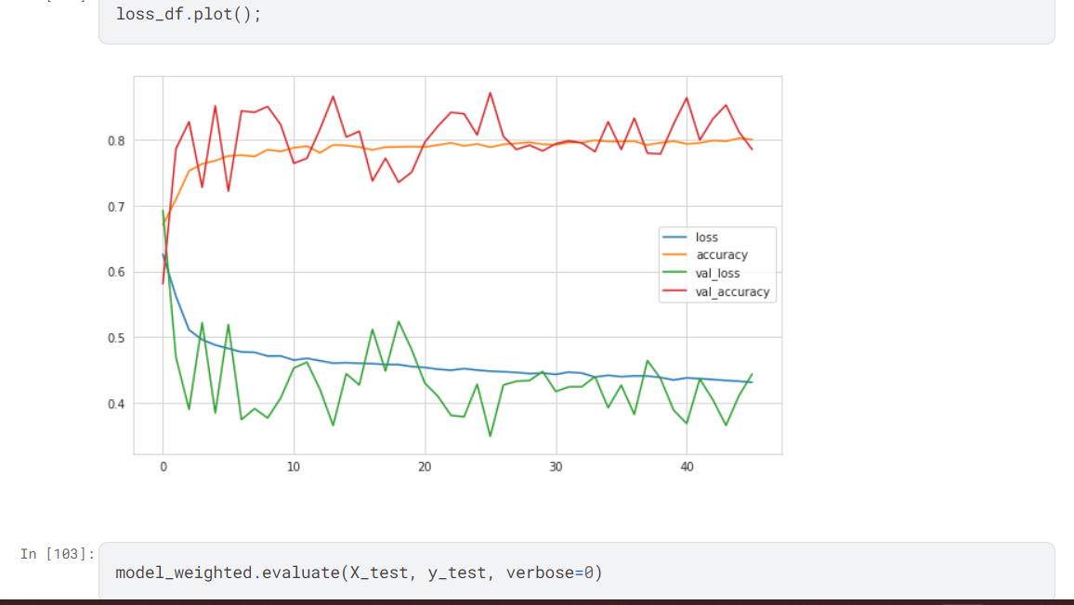
OUTPUT

Slide 19
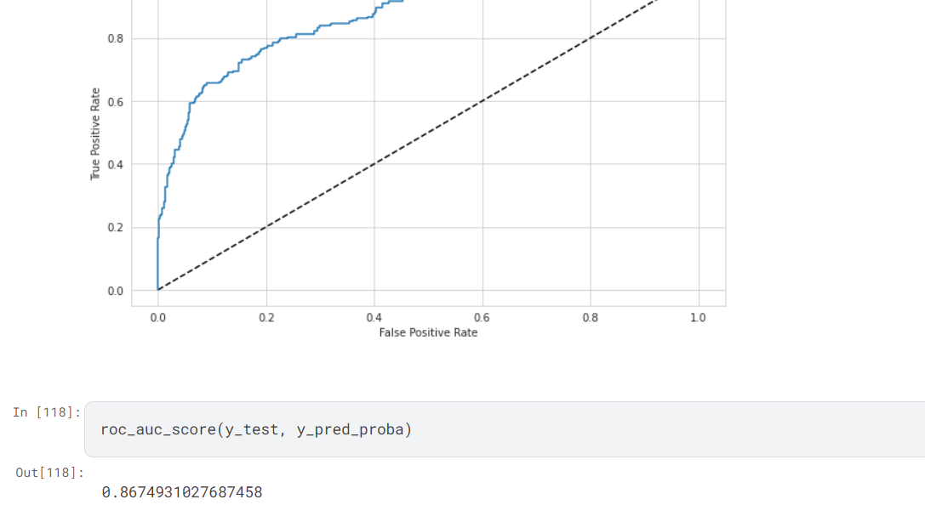

Slide 20
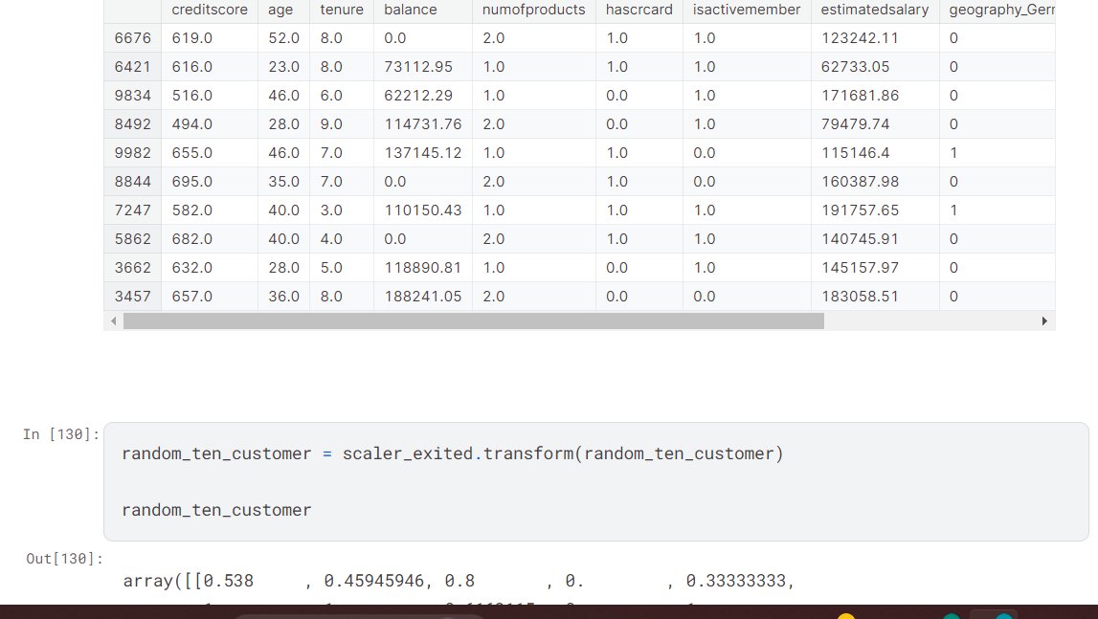

Slide 21
THANK YOU !

